Slide 1
MAGNITUDE OF COMPLEX NUMBERS AND ANGLE
MUHAMMAD ALI MAHMOOD
2021346

Slide 2
Problem statement
We have to build which finds the magnitude and angle of a complex number.

Slide 3
Introduction
We will make this program using math functions such as squareroots and tangent to find the magnitude and angle of the complex number.User will enter real and imaginary number and we will calculate.

Slide 4
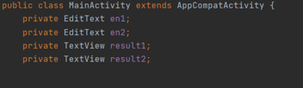
CODE DESCRIPTION: EditText is used for taking inputs.We have to take one real input and one imaginary input. TextView is used for output.We have to output the magnitude and angle separately.

Slide 5

This code links the buttons to the java code.

Slide 6
Magnitude of complex numbers:
-Magnitude is the square root of the sum of the squares of real and imaginary value

Slide 7
ANGLE OF A COMPLEX NUMBER:
Angle is calculated by tangent inverse of imaginary value divided by real value.
This tan function gives the angle in radians so if we want to convert the angle to degrees we can multiply it by180 and divide by pi.

Slide 8
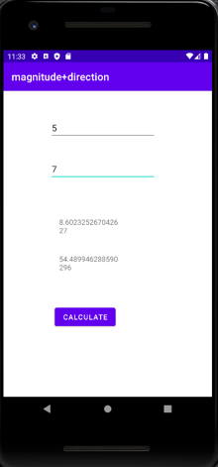
We enter the real number first and then the imaginary number. The output of magnitude and angle is given in degrees.

Slide 9
Conclusion
Programs like these are very useful in real life and we should try and make more projects like these.

